Slide 1

Omega
Presented by:
Palak munet(Leader)
Parul
Nivedita shanker
Pradeep saini
Prateek Talesara

Slide 2
Problem Statement
Using technology to create a credit profile of e-commerce customers:
The e-commerce companies find it very difficult to profit since their are lot of return backs and cancellations in e-commerce orders. Also even when orders are properly accepted the customer may want to pay by EMI. Thus their needs to be a system to create a credit and buying profile of a customer. This has to be done in a way that it does not create privacy issue for the customer. The developer should use data from customers and try to use technologies like big data/AI/statistical analysis to create a profile of customer without compromising his or her privacy. Then based on that the system should give delivery benefits and EMI options to the user. So a customer who has negative buying profile will not get Cash on Delivery option. Similarly customers with negative credit profile will not get EMI options.

Slide 3
Problem We Understood:
According to company perspective we see there are many loss making factors which they are facing and we made are solution to overcome those.
User are also a factor which is also a loss making. Any company have users as biggest asset which decide the profit of company .

Slide 4
Solution
We have created a solution that can solve both end problem . From company perspective we have taken factors that helps in calculating a score, which helps company to decide which features they can provide to whom .
This also help users as having a good score may brings more features and low score decreases the feature count and may result in removing of basic feature.
Technology Stack:
Python 3
Apache HTTP 2.4 Server
Python Libraries

Slide 5
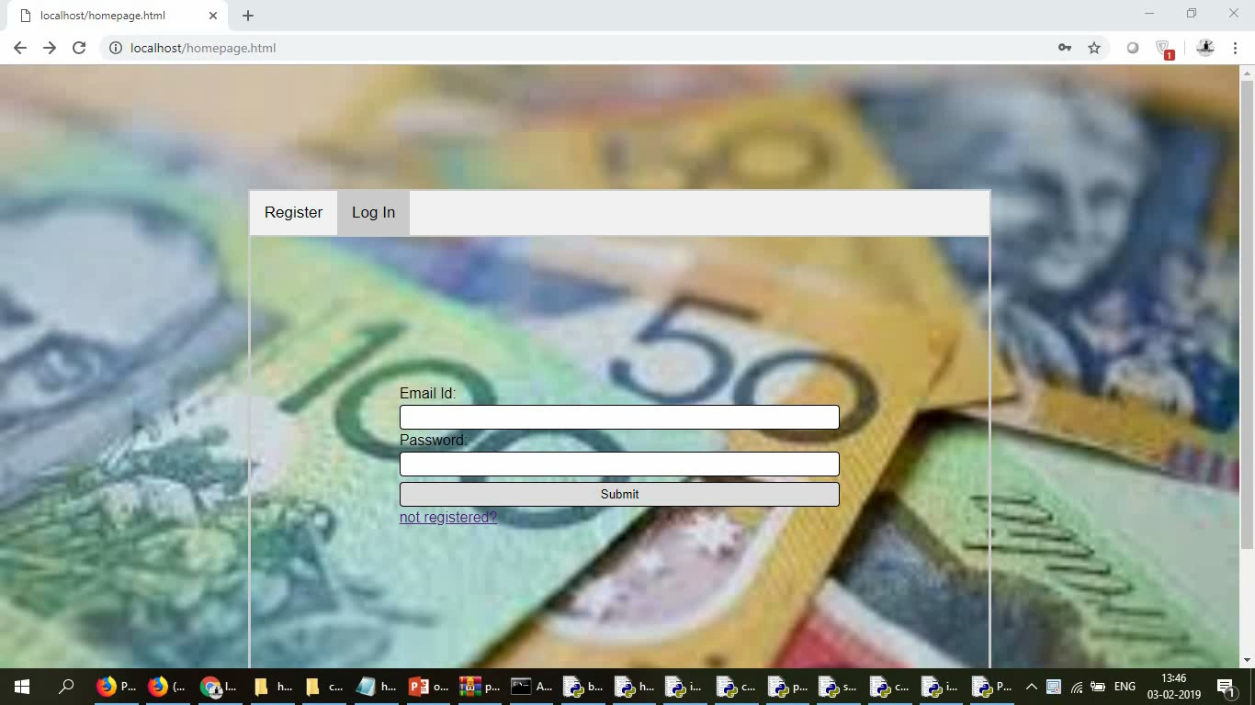
Demo

Slide 6
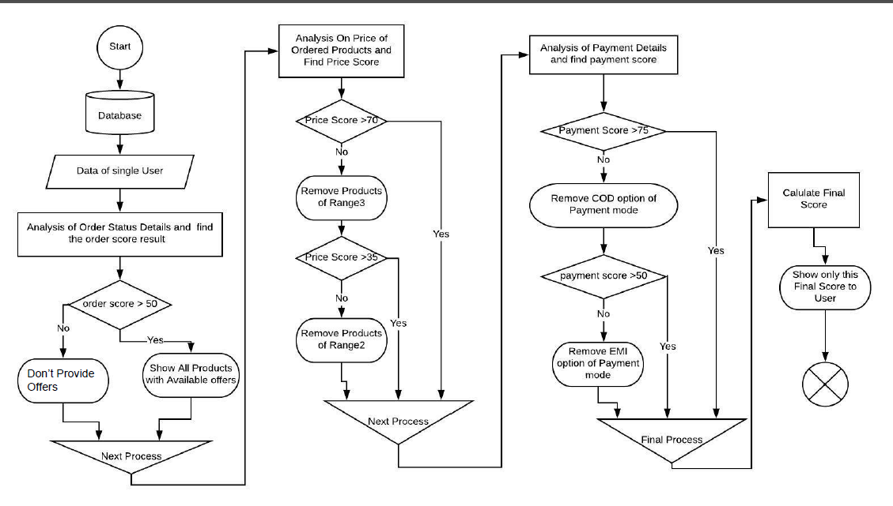
Architecture

Slide 7


